Slide 1
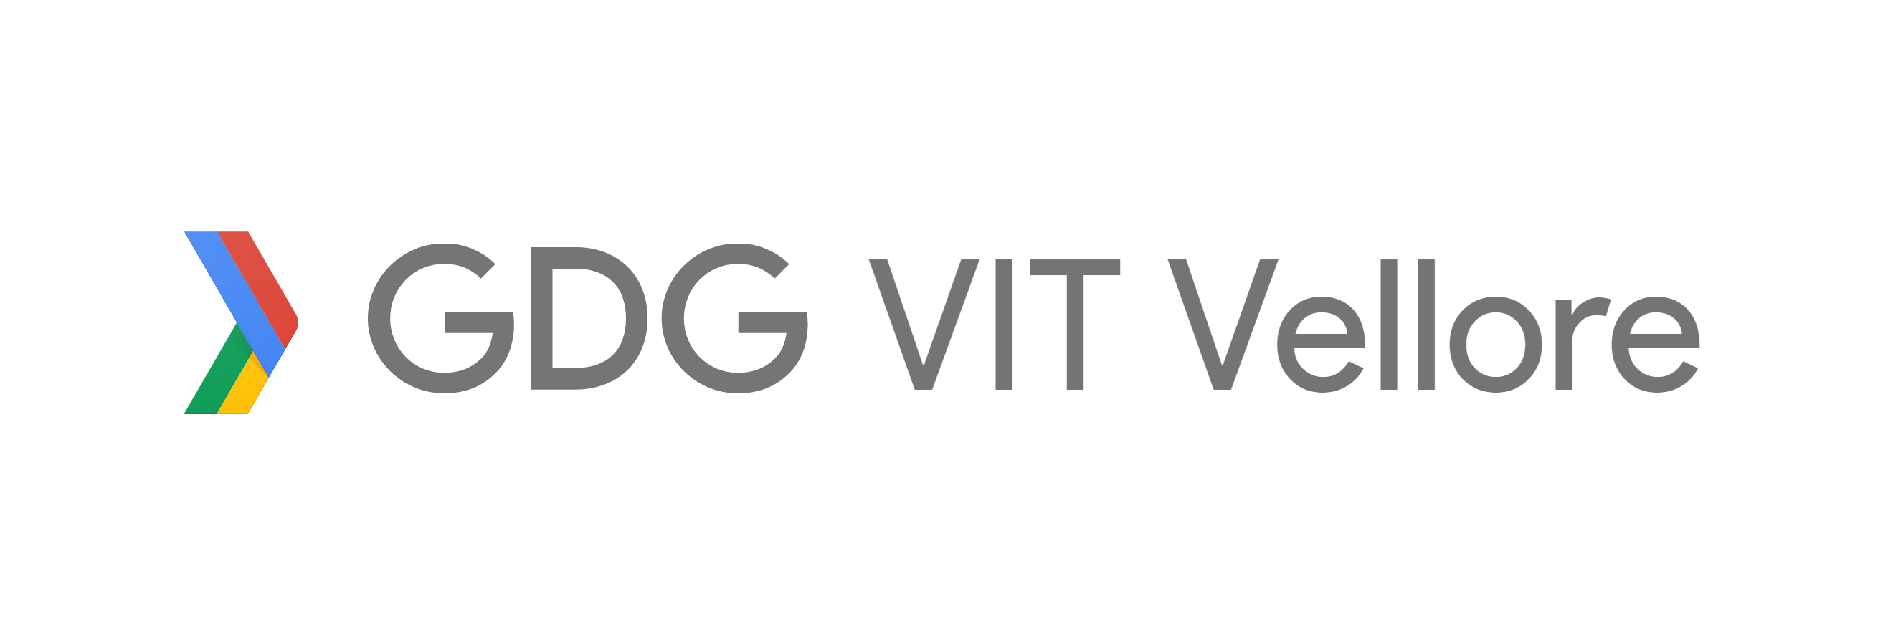
SubConn Subsidy Connections

Slide 2
Problem Statement
The government spends Rs. 750 billion ($13.6 billion) per year on the Public Distribution System (PDS).
With the total subsidies provided added up to a staggering Rs. 2400 billion.
<number>

Slide 3
Solution
Tracking the products from the supplier to the consumer through the chain.
Emiminate tampering by middlemen.
Maintain quality control of the goods.
<number>

Slide 4
Expiry Date constraint
Low Capital investment
Anti-tamper technology using block-chain
Doesnt require the end users to possess any device
Completely distributed nature of the database makes it impossible for scams to happen.
<number>

Slide 5
Expected output
Reduce losses to 10%.
Prevent theft by middlemen.
Good quality produce reaches targeted consumers.
<number>

Slide 6
Tools and Platforms
Tagging each item using a QR code.
Development of a Progressive Web Application (PWA).
<number>

Slide 7
Tools and Platforms Contd.
Secure and open database using NoSQL and Blockchain to prevent any tampering.
Aadhar API to validate and verify the agents and consumers.
<number>

Slide 8
Tansaction backtracking
B
C
A
F
D
E
<number>

